Slide 1

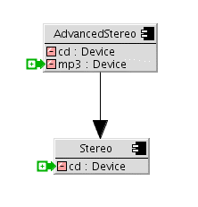
Modeling with Deltas
Implementing the Backbone formal model
Andrew McVeigh, 17/10/'07

Slide 2
The Backbone Alloy Model
Describes how deltas are applied to get ”full” components and interfaces
  Takes resemblance and redefinition into account
Models ”stratum perspective”
Covers most of Backbone
  Abstraction level is components, interfaces and relationships
  Port type inference is described
  -- but ---
  No factories, placeholders, delegate connectors
  Does not flatten

Slide 3
Requirements for implementation
Common code for CASE tool and interpreter
Must be robust even in the presence of errors
  Easy to rule out whole classes of errors in formal model. e.g. circular resemblance
  ”Temporary” model errors are common while desigining in a CASE tool
Must be efficient and scalable
  ”On the fly” error checking in CASE tool
  Full checking of large models must be possible

Slide 4
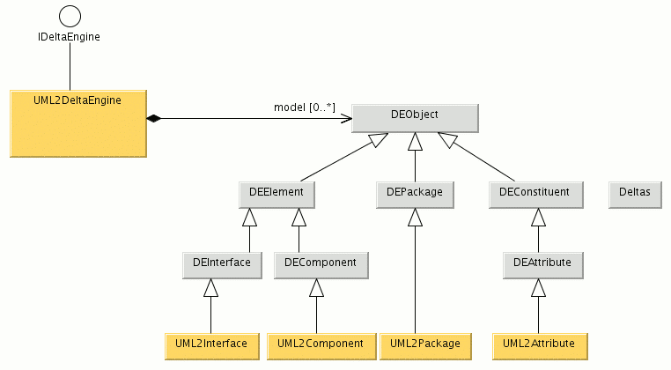
Common code base
Need ”simple” model for common code base...
  CASE tool has ”fat and complex” UML2 model
  Interpreter doesn't want this baggage
Solution:
factory + ”bridge”
patterns
complex rules live in the abstraction classes
the factory for UML2 objects
UML2 navigation logic here.
Objects link directly to the UML2 repostiroy...

Slide 5
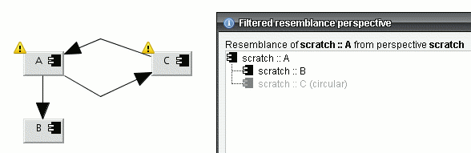
Making it robust...
Sensible handling of cycles is the key
  Resemblance cycles are truncated
  Cycles in strata dependencies cause resemblance cycles, which are handled by 1st rule

Slide 6
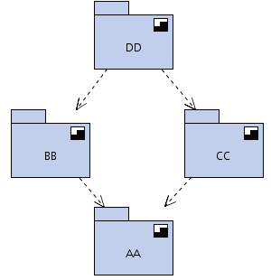
Making it scalable
Deltas must be applied ”on-the-fly” to show expanded items
  Only handle items on diagram + necessary others
  Fast enough to do nearly all error checks
  ”on-the-fly” also...
  Fast even with a database
For deeper checks
  Check a stratum at a time,
  in graph order
  Still expensive, but probably ok
3
2a
2b
1

Slide 7
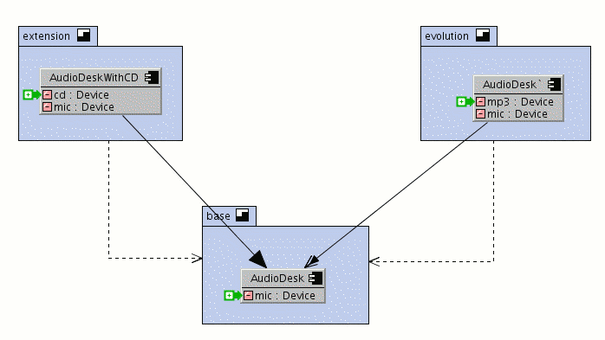
Graphical treatment
Tool records deltas, but shows expanded items
  Uses optional adornments to show what has been added / deleted / replaced

Slide 8
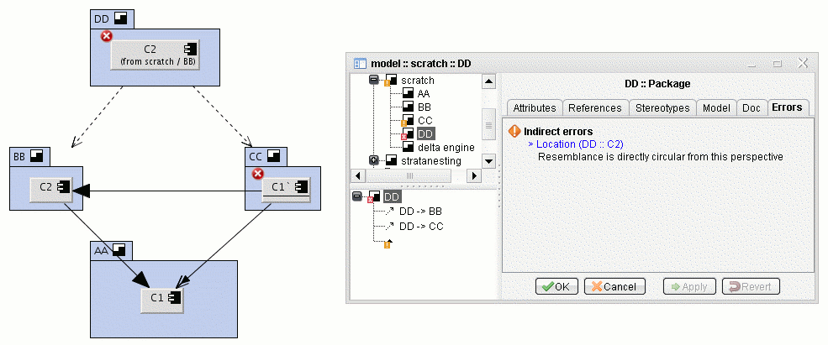
Depiction of errors
Error can be recorded against expanded items
  E.g. component C2 is ok where it is defined, but has an error in stratum DD
  Aggregate errors up to the nearest ”real” element

Slide 9
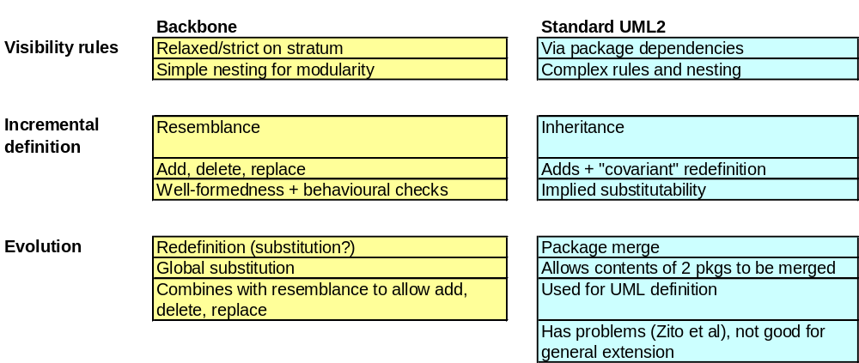
Backbone vs Standard UML
Backbone is still “UML”
  Extended via standard stereotype mechanism
  A stratum is just a sterereotyped package
  Resemblance and redefinition are stereotyped dependencies
  Composite structure diagrams used for modeling

Slide 10
Conclusions
Formal model is well suited for implementation
  Abstraction level is component and interfaces
  Refinement to implementation is straight forward
But
  1 line in the formal model can translate to 100's of Java lines: E.g. s not in s.^dependsOn
  Graphical treatment is time consuming and detailed
Good progress being made; slower than hoped
  Aim to finish graphics by end '07

